Slide 1

深度学习框架介绍
Tensors
Autograd
Examples
Extension
Experiment
郑歆慰
2019年4月15日

Slide 2

深度学习框架
Tensors
Autograd
Examples
Extension
Experiment
深度学习需要大量的计算
数据量和节点数量是主要计算需求来源
神经网络的结构适用于GPU进行高效并行计算
深度学习框架的创建目标是在GPU上高效运行深度学习系统
提供基础的数据结构
利用计算图实现自动求导和性能优化
Notes:
它通常包含具有许多节点的神经网络，并且每个节点都有许多需要在学习过程中必须不断更新的连接。换句话说，神经网络的每一层都有成百上千个相同的人工神经元在执行相同的计算。因此，神经网络的结构适用于GPU（图形处理单元）可以高效执行的计算类型（GPU是专门为并行计算相同指令而设计的）。
随着深度学习和人工智能在过去几年的迅速发展，我们也看到了许多深度学习框架的引入。深度学习框架的创建目标是在GPU上高效运行深度学习系统。这些深度学习框架都依赖于计算图的概念，计算图定义了需要执行的计算顺序。在这些框架中你使用的是一种可以建立计算图的语言，并且语言的执行机制与其宿主语言本身的机制有所不同。然后，计算图可以并行地在目标GPU中优化和运行。

Slide 3
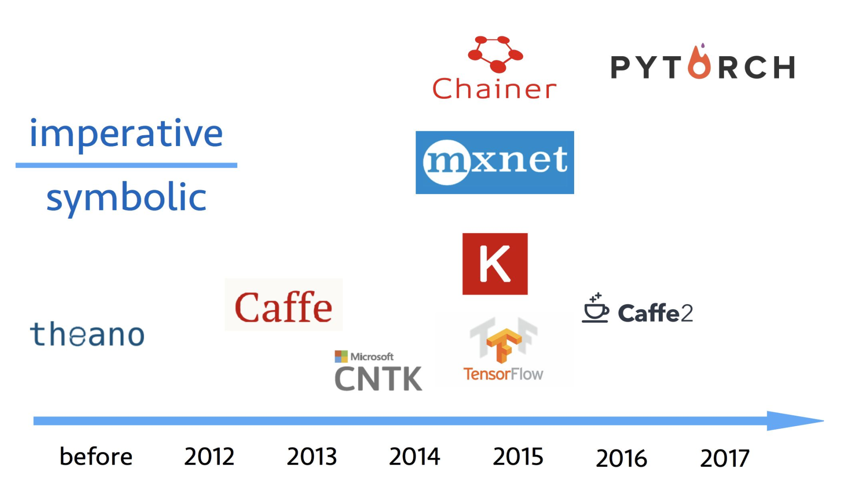
深度学习框架
Tensors
Autograd
Examples
Extension
Experiment

Slide 4
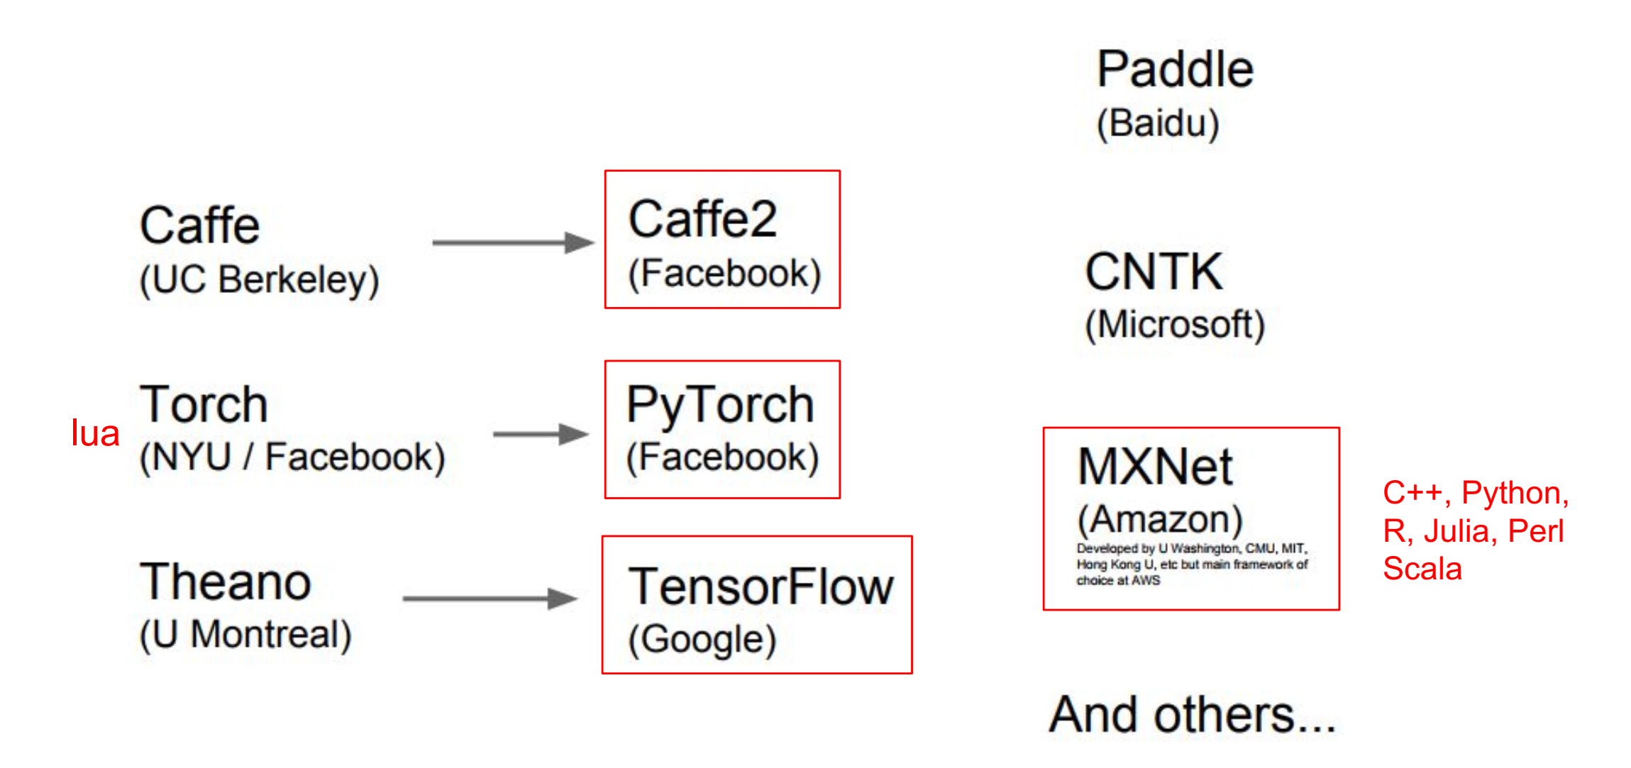
深度学习框架
Tensors
Autograd
Examples
Extension
Experiment

Slide 5

Disclaimer
Tensors
Autograd
Examples
Extension
Experiment
深度学习框架仍在高速地发展中
本节课内容基于v1.0.1版本
官方教程：https://pytorch.org/tutorials/beginner/deep_learning_60min_blitz.html
穿插一些随堂练习

Slide 6
Pytorch概述
Tensors
Autograd
Examples
Extension
Experiment
版本历史（https://github.com/pytorch/pytorch/releases）
2016.9.1 alpha-1; 2017.2.2 beta
2017.8.28 v0.2 Distributed PyTorch, Broadcasting, Advanced …
2017.12.5 v0.3 Performance improvements, ONNX, CUDA9, CuDNNv7 …
2018.4.25 v0.4 Windows support, Tensor-Variable merge, …
2018.12.8 v1.0 JIT Compiler, Faster Distributed, C++ Frontend, …
PyTorch is an optimized Tensor library for deep learning using GPUs and CPUs.
A replacement for NumPy to use the power of GPUs
A deep learning research platform that provides maximum flexibility and speed

Slide 7
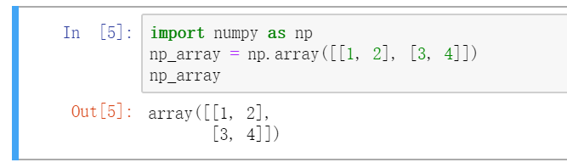
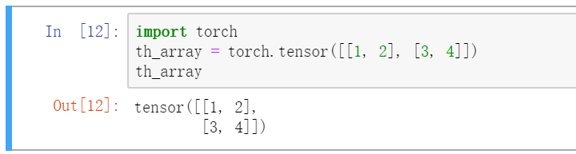
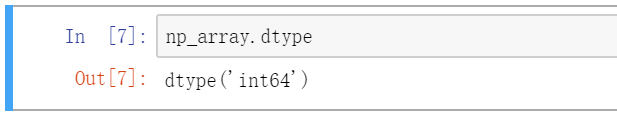
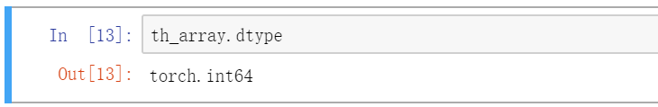

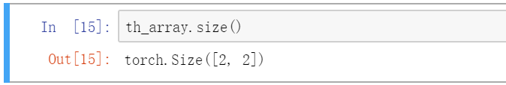
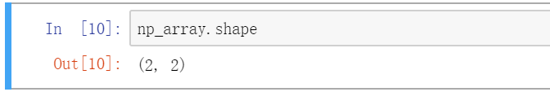
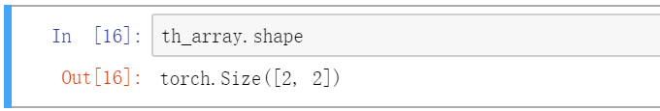
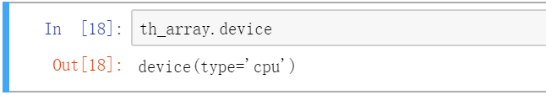
Tensors
Tensors
Autograd
Examples
Extension
Experiment
A tensor is a generalization of vectors and matrices to potentially higher dimensions
numpy.ndarray
torch.tensor

Slide 8
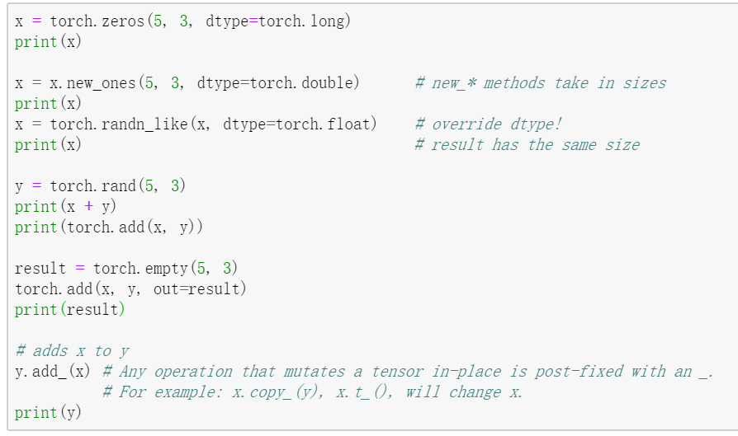
Operations
Tensors
Autograd
Examples
Extension
Experiment
100+ Tensor operations, including transposing, indexing, slicing, mathematical operations, linear algebra, random numbers, etc., are described here.

Slide 9
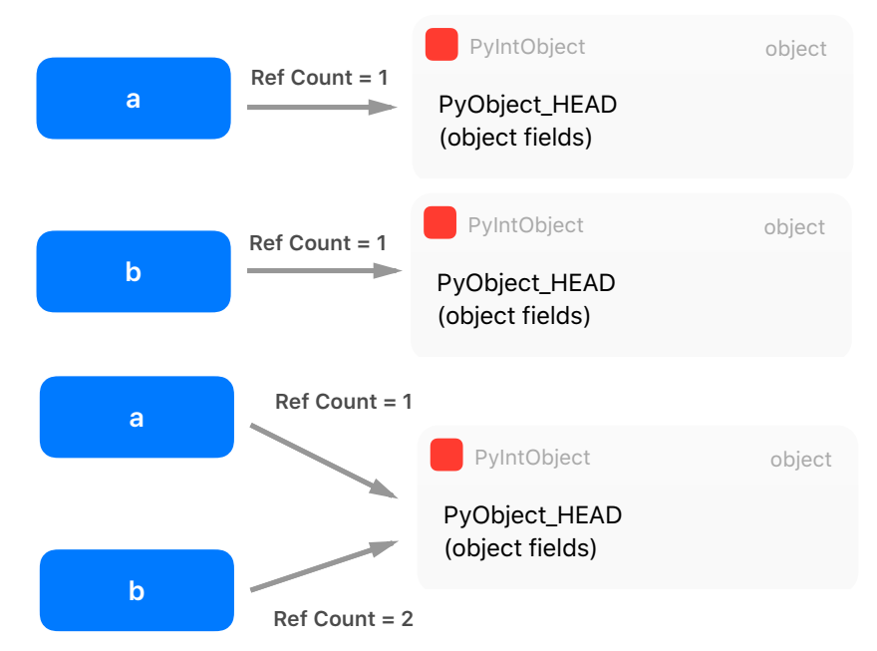
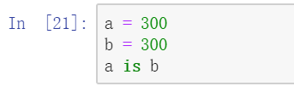
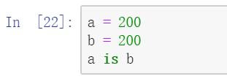
练习1
Tensors
Autograd
Examples
Extension
Experiment
我们知道在python中一切都是对象，那么下面代码的运行结果是什么？
那么这段代码的结果呢？
A、True B、False
A、True B、False
A、True B、False
A、True B、False
CPython是Python的官方解释器，它会对小整数进行缓存，默认的范围是-5到257
Notes:
产生和销毁一个对象是有开销的，所以CPython会对小整数进行缓存，默认的范围是-5到257，也就是说，在这个范围内的数字，CPython会直接使用缓存的引用地址，也就是说，所有在这个范围内的小整数，都是指向同一个地址。

Slide 10
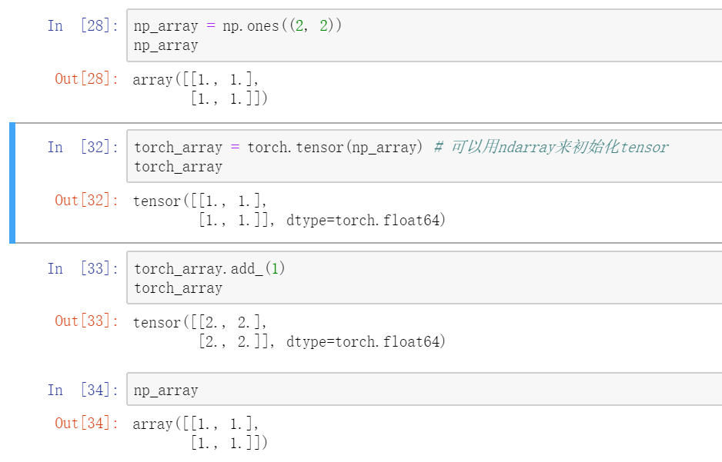
Numpy Array与Torch Tensor的相互转换
Tensors
Autograd
Examples
Extension
Experiment

Slide 11
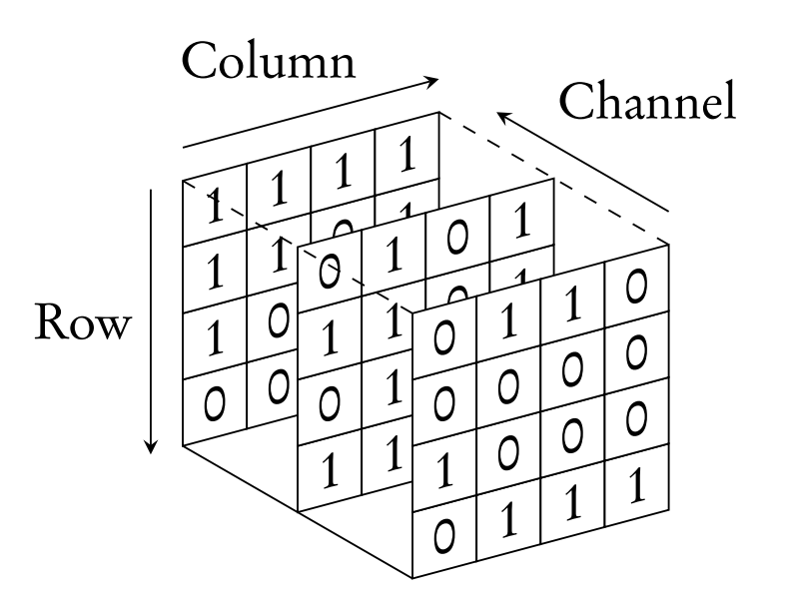
Numpy Array与Torch Tensor的相互转换
Tensors
Autograd
Examples
Extension
Experiment
假设有一个batch：128张图片，3通道（RGB），224*224大小
将产生~74MB的内存

Slide 12
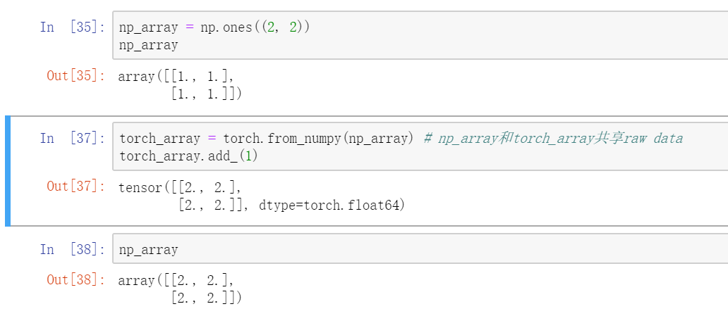
Numpy Array与Torch Tensor的相互转换
Tensors
Autograd
Examples
Extension
Experiment
更推荐使用torch.from_numpy()来初始化
All the Tensors on the CPU except a CharTensor support converting to NumPy and back.
Notes:
numpy()

Slide 13
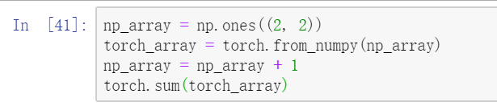
练习2
Tensors
Autograd
Examples
Extension
Experiment
下面代码的运行结果是什么样的？
A、4
B、8
C、tensor(4., dtype=torch.float64)
D、tensor(8., dtype=torch.float64)
A、4
B、8
C、tensor(4., dtype=torch.float64)
D、tensor(8., dtype=torch.float64)
Notes:
np_array + 1产生了新的对象

Slide 14
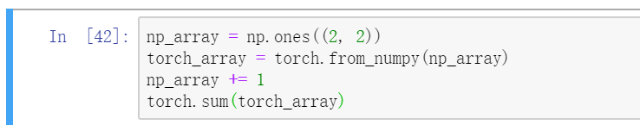
练习3
Tensors
Autograd
Examples
Extension
Experiment
下面代码的运行结果是什么样的？
A、4
B、8
C、tensor(4., dtype=torch.float64)
D、tensor(8., dtype=torch.float64)
A、4
B、8
C、tensor(4., dtype=torch.float64)
D、tensor(8., dtype=torch.float64)
Notes:
+=是一个原位(in-place)操作

Slide 15
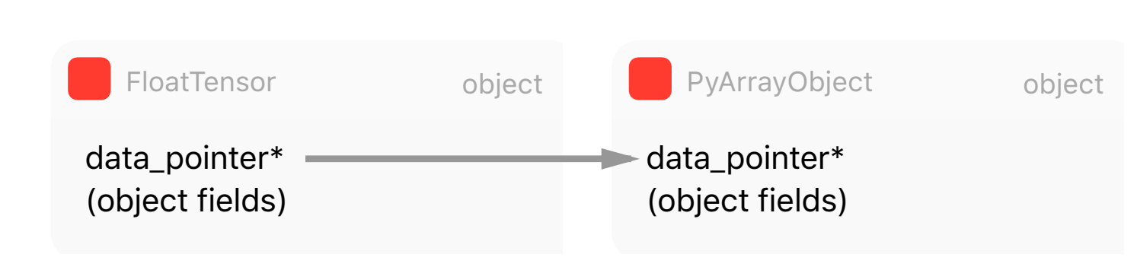
Data Pointer
Tensors
Autograd
Examples
Extension
Experiment
Torch Tensor拷贝了numpy array的数据指针，而不是内容。
通过使用python的引用计数机制来保证引用的安全性

Slide 16
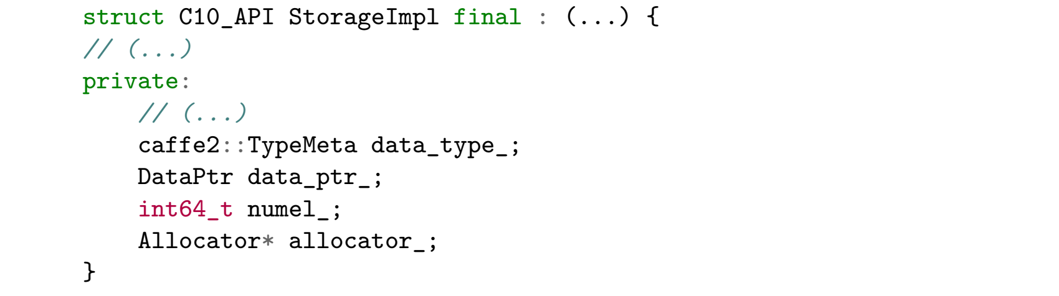
Tensor Storage
Tensors
Autograd
Examples
Extension
Experiment
Tensor并不保存数据，而是通过Storage
保存了指向raw data的指针、大小、allocator等信息
Storage并不负责解析数据，数据怎么解读由tensor负责

Slide 17
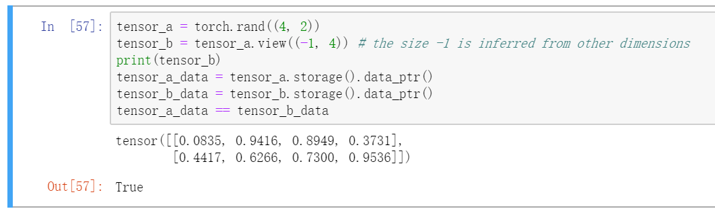
Tensor Storage
Tensors
Autograd
Examples
Extension
Experiment
通过Storage的抽象，使得raw data和解析方法可以解耦
view函数：可以定义多个tensor而共享相同的storage

Slide 18
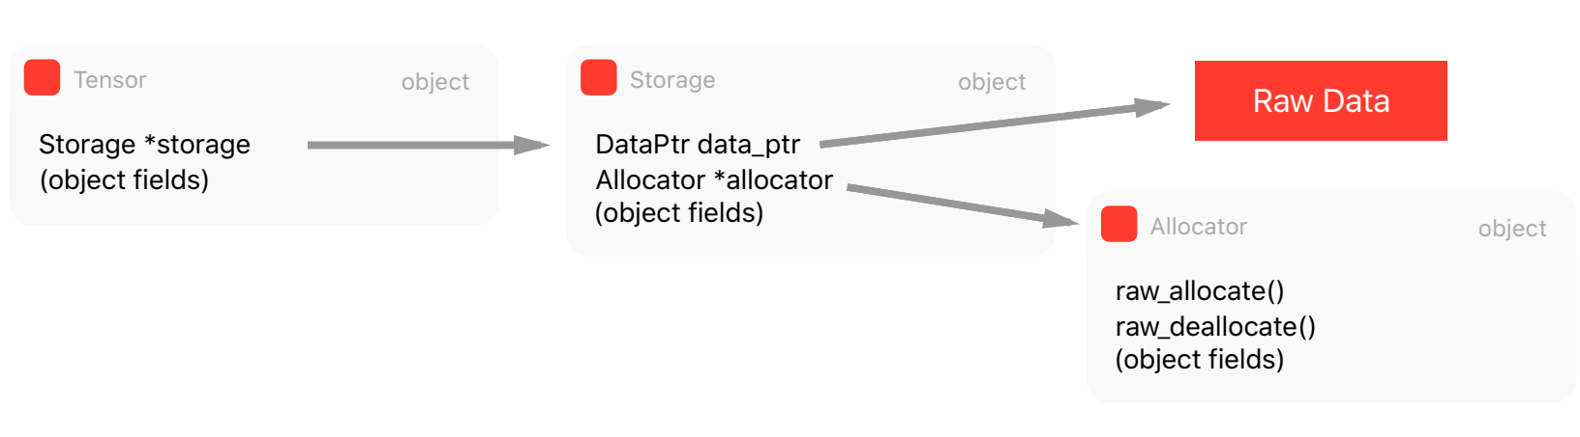
Data Pointer
Tensors
Autograd
Examples
Extension
Experiment
Tensor的Storage属性指向了raw data和Allocator来确定数据所在的设备

Slide 19
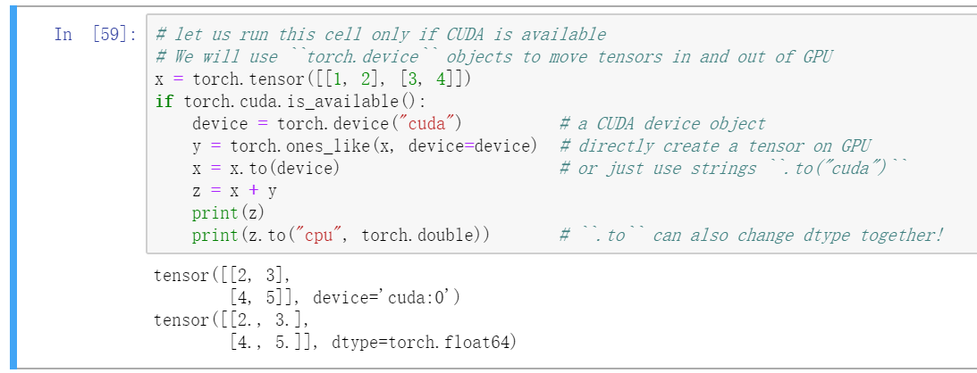
CUDA Tensor
Tensors
Autograd
Examples
Extension
Experiment
Tensors can be moved onto any device using the .to method.

Slide 20
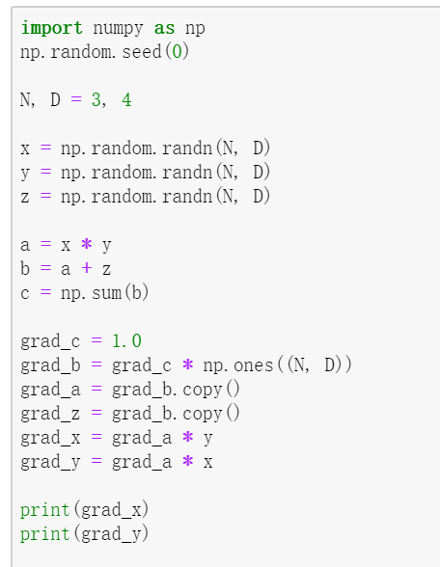
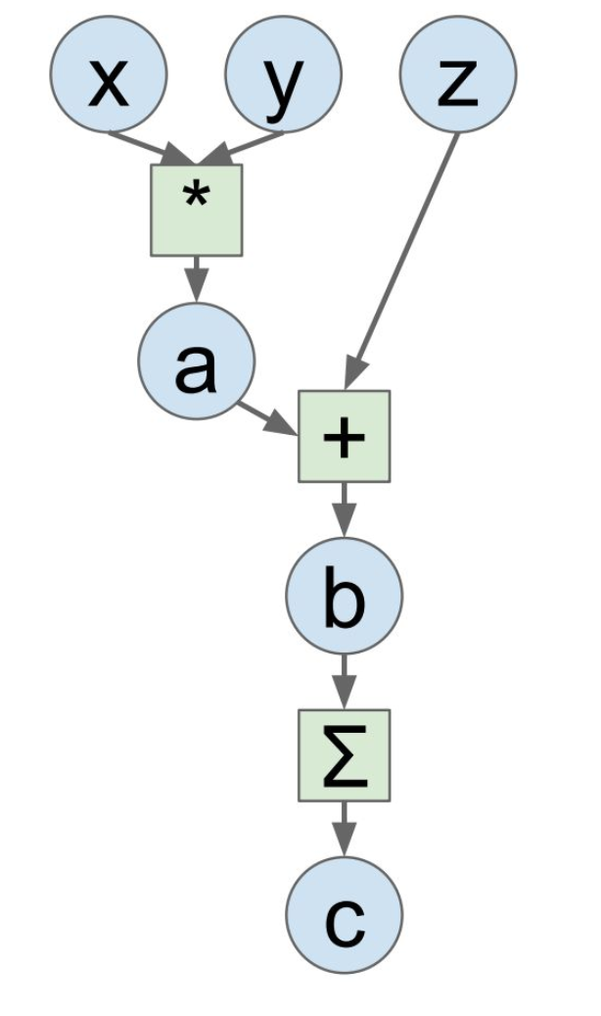
计算图——一种描述函数的语言
Tensors
Autograd
Examples
Extension
Experiment
Write with numpy

Slide 21
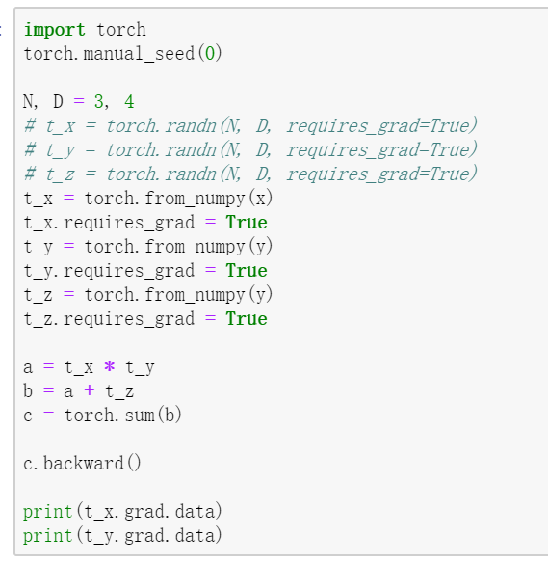
计算图——一种描述函数的语言
Tensors
Autograd
Examples
Extension
Experiment
Write with pytorch

Slide 22
Autograd
Tensors
Autograd
Examples
Extension
Experiment
The autograd package provides automatic differentiation for all operations on Tensors. It is a define-by-run framework, which means that your backprop is defined by how your code is run, and that every single iteration can be different.
If you set its attribute .requires_grad as True, it starts to track all operations on it. When you finish your computation you can call .backward() and have all the gradients computed automatically. The gradient for this tensor will be accumulated into .grad attribute.

Slide 23
Autograd
Tensors
Autograd
Examples
Extension
Experiment
Function类在自动求导机制实现过程中起了很大作用
Tensor and Function are interconnected and build up an acyclic graph, that encodes a complete history of computation. Each tensor has a .grad_fn attribute that references a Function that has created the Tensor (except for Tensors created by the user - their grad_fn is None).

Slide 24
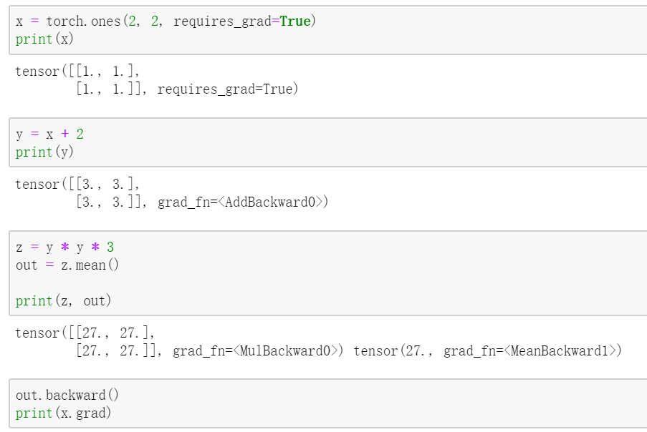
Autograd代码示例
Tensors
Autograd
Examples
Extension
Experiment

Slide 25
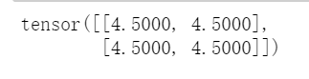
练习4
Tensors
Autograd
Examples
Extension
Experiment
下列代码的运行结果是什么样的？

Slide 26
练习5
Tensors
Autograd
Examples
Extension
Experiment
函数 f(x, y) = max(x, y) 的导数是什么样的？

Slide 27
Autograd
Tensors
Autograd
Examples
Extension
Experiment
If you want to compute the derivatives, you can call .backward() on a Tensor. If Tensor is a scalar (i.e. it holds a one element data), you don’t need to specify any arguments to backward(), however if it has more elements, you need to specify a gradient argument that is a tensor of matching shape.

Slide 28
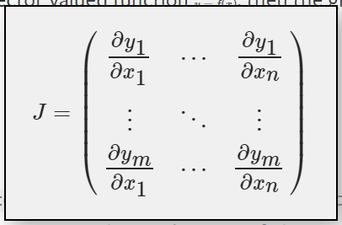
向量求导
Tensors
Autograd
Examples
Extension
Experiment
if you have a vector valued function y⃗ =f(x⃗ ), then the gradient of y⃗ with respect to x⃗ is a Jacobian matrix:

Slide 29
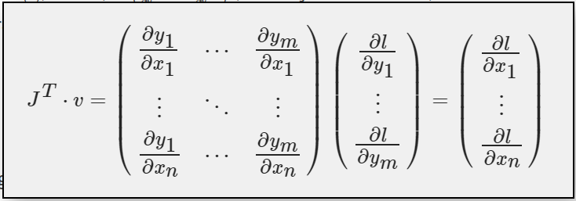
向量求导
Tensors
Autograd
Examples
Extension
Experiment
Generally speaking, torch.autograd is an engine for computing vector-Jacobian product. That is, given any vector v=(v1v2⋯vm)T, compute the product vT⋅J. If v happens to be the gradient of a scalar function l=g(y⃗ ), that is, v=(∂l∂y1⋯∂l∂ym)T, then by the chain rule, the vector-Jacobian product would be the gradient of l with respect to x⃗ :

Slide 30
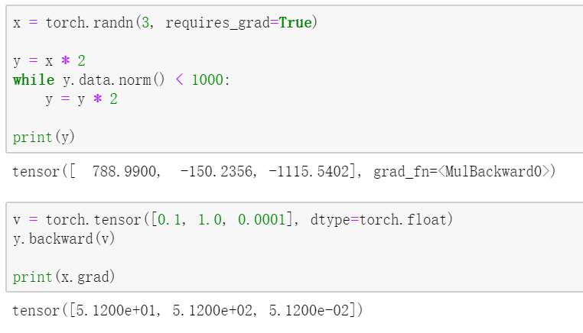
向量求导示例
Tensors
Autograd
Examples
Extension
Experiment

Slide 31
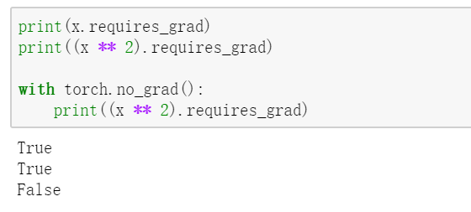
取消自动求导
Tensors
Autograd
Examples
Extension
Experiment
You can also stop autograd from tracking history on Tensors with .requires_grad=True by wrapping the code block in with torch.no_grad():

Slide 32
Tensor & Variable
Tensors
Autograd
Examples
Extension
Experiment
在早期的pytorch版本中，自动求导和Tensor的概念是分离的，但从v0.4.0版本起，Variable合并到Tensor中
Pytorch的自动求导是基于ATen框架构建的
ATen是一个基础的tensor操作算子库，更多的阅读材料参考：https://github.com/pytorch/pytorch/tree/master/aten/src

Slide 33
练习6
Tensors
Autograd
Examples
Extension
Experiment
以下是机器学习的几个主要流程，一般而言，正确的顺序是什么样的？
(1) 计算梯度
(2) 准备训练数据，并计算loss
(3) 更新模型参数
(4) 设计神经网络结构
(4) -> (2) -> (1) -> (3)

Slide 34

练习7
Tensors
Autograd
Examples
Extension
Experiment
下图是LeNet的网络结构，下列选项中哪个选项最接近它的参数量？
A、12K B、24K C、48K D、1M
A、12K B、24K C、48K D、1M

Slide 35
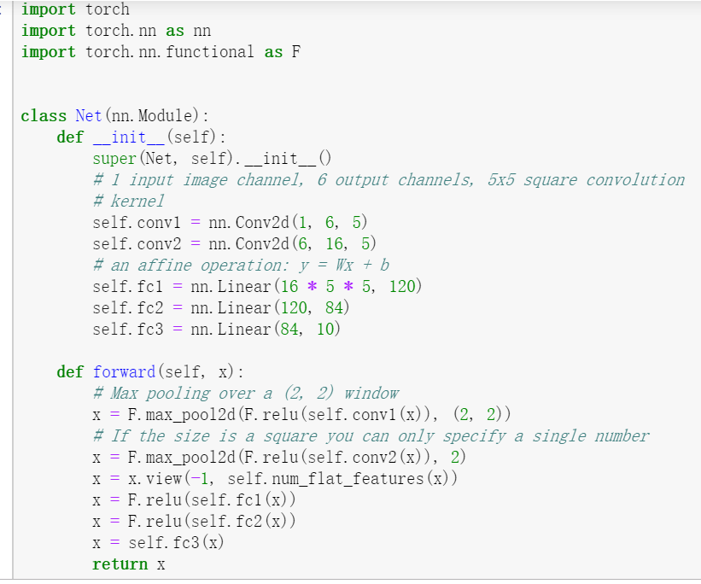
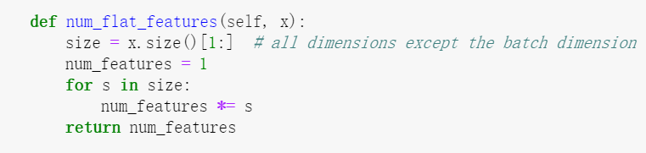
LeNet——Step1 网络结构设计
Tensors
Autograd
Examples
Extension
Experiment

Slide 36
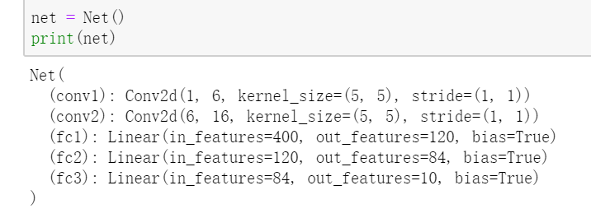
Step1 网络结构设计
Tensors
Autograd
Examples
Extension
Experiment
练习8：上图的输出能完整地代表LeNet的网络结构吗？

Slide 37
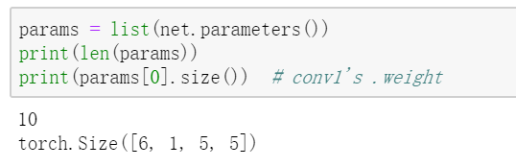
Step1 网络结构设计——模型参数
Tensors
Autograd
Examples
Extension
Experiment
The learnable parameters of a model are returned by net.parameters()

Slide 38
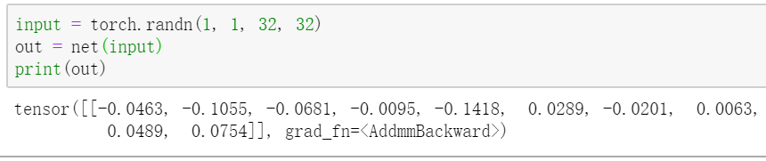
Step2 计算loss
Tensors
Autograd
Examples
Extension
Experiment
网络的输出：
torch.nn只支持mini-batches的输入
如nn.Conv2d的输入是一个4D Tensor：nSamples * nChannels * Height * Width.

Slide 39
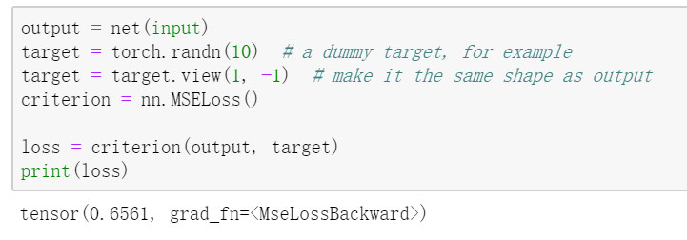
Step2 计算loss
Tensors
Autograd
Examples
Extension
Experiment
A loss function takes the (output, target) pair of inputs, and computes a value that estimates how far away the output is from the target.
There are several different loss functions under the nn package . A simple loss is: nn.MSELoss which computes the mean-squared error between the input and the target.
Notes:
均方误差

Slide 40
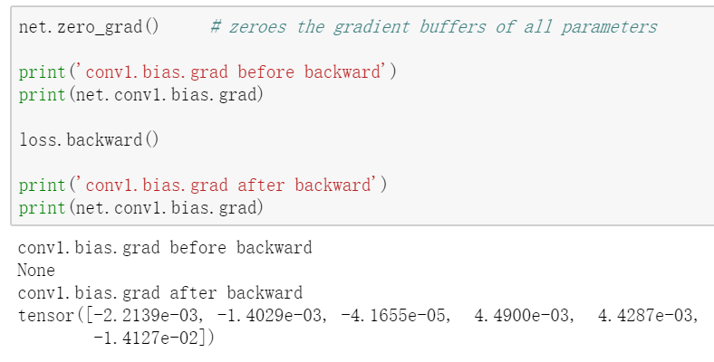
Step3 计算导数
Tensors
Autograd
Examples
Extension
Experiment
通过调用 loss.backward() 计算导数

Slide 41
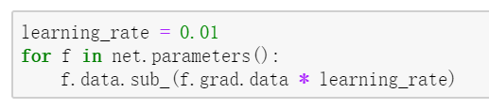
Step4 更新模型参数
Tensors
Autograd
Examples
Extension
Experiment
随机梯度下降法（Stochastic Gradient Descent ，SGD）
weight = weight - learning_rate *gradient

Slide 42
练习9
Tensors
Autograd
Examples
Extension
Experiment
在计算梯度的时候，我们可以增大batchsize的数量，当batchsize达到一定量时，下列那项会成为最主要瓶颈？
A、计算力 B、内存或显存 C、硬盘空间
A、计算力 B、内存或显存 C、硬盘空间

Slide 43
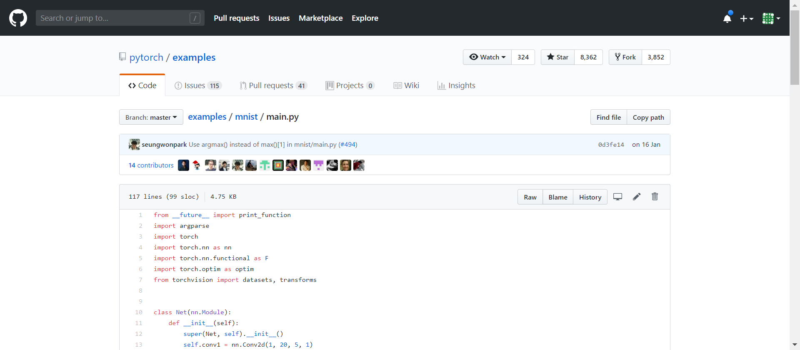
pytorch/examples/mnist
Tensors
Autograd
Examples
Extension
Experiment

Slide 44
还没讲到的：
Tensors
Autograd
Examples
Extension
Experiment
DataLoader
Optimizer

Slide 45
Data Loading——Dataset
Tensors
Autograd
Examples
Extension
Experiment
A lot of effort in solving any machine learning problem goes in to preparing the data.
torch.utils.data.Dataset is an abstract class representing a dataset.
Your custom dataset should inherit Dataset and override the following methods:
__len__ so that len(dataset) returns the size of the dataset.
__getitem__ to support the indexing such that dataset[i] can be used to get ith sample
Notes:
PyTorch provides many tools to make data loading easy and hopefully, to make your code more readable.

Slide 46
Transform
Tensors
Autograd
Examples
Extension
Experiment
大部分神经网络希望输入是固定大小的，通常就需要编写预处理代码
几个例子:
Rescale: 缩放图片
RandomCrop: 随机裁剪，以达到数据增广
ToTensor: 将存储为Numpy格式的图像转化为Tensor，可能还会伴随着矩阵转置
Transform需要定义__call__ 函数，以使其对象可被调用
多个Transform可以通过torchvision.transforms.Compose 进行组合

Slide 47
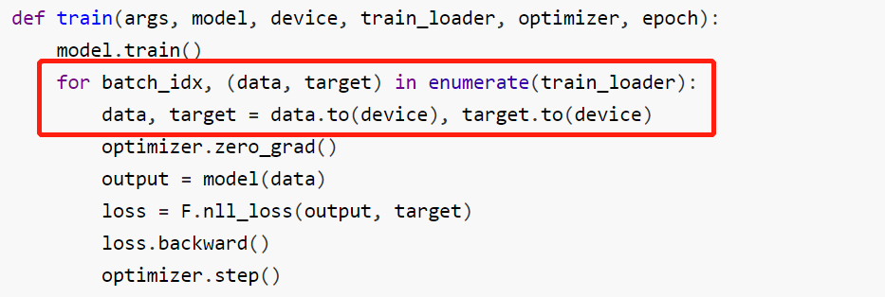
DataLoader
Tensors
Autograd
Examples
Extension
Experiment
torch.utils.data.DataLoader负责提供：
Batching
Shuffling
多线程操作
通过enumerate获取批数据

Slide 48
torch.optim
Tensors
Autograd
Examples
Extension
Experiment
最优化方法：https://www.bilibili.com/video/av15997678/?p=16
其他参考资料：An overview of gradient descent optimization algorithms（http://ruder.io/optimizing-gradient-descent/index.html）

Slide 49
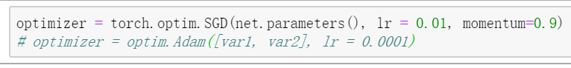
torch.optim
Tensors
Autograd
Examples
Extension
Experiment
torch.optim包含很多可以用来更新参数的优化算法，比如SGD、AdaGrad、RMSProp、 Adam等
在使用torch.optim前，需要构建一个optimizer对象。这个对象能够保持当前参数状态并基于计算得到的梯度进行参数更新
所有的optimizer都实现了step()方法，这个方法会更新所有的参数。一旦梯度被如backward()之类的函数计算好后，我们就可以调用optimizer.step()来更新参数

Slide 50
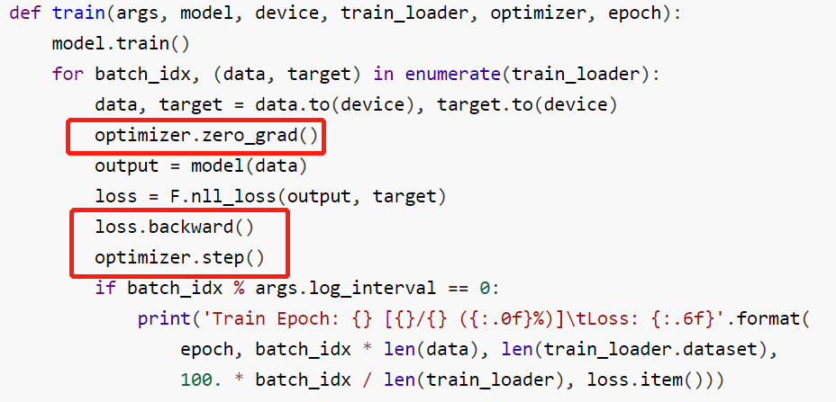
torch.optim
Tensors
Autograd
Examples
Extension
Experiment

Slide 51
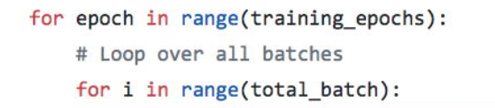
练习10
Tensors
Autograd
Examples
Extension
Experiment
下列代码中，哪一层循环结束后，表示完成了一次完整的数据集遍历
A、外层循环 B、内层循环
A、外层循环 B、内层循环

Slide 52
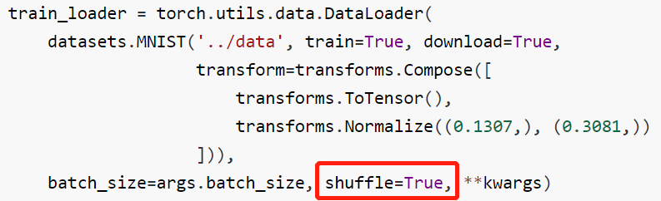
练习11
Tensors
Autograd
Examples
Extension
Experiment
“数据集进行shuffling之后，通常能使得模型具有更好的效果”，这样的表述对吗
A、正确 B、错误
A、正确 B、错误

Slide 53
回顾一次“炼丹”之旅
Tensors
Autograd
Examples
Extension
Experiment
定义一个nn.Module的子类
定义网络层
定义forward()函数，用nn.Functional构建计算图
加载数据集进行迭代训练
是否有更快的网络定义方式？

Slide 54
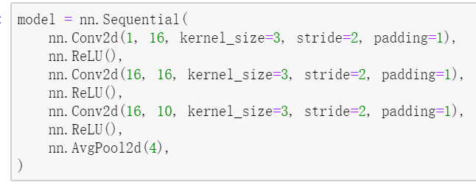
torch.nn.Sequential
Tensors
Autograd
Examples
Extension
Experiment
一个有序的容器，神经网络模块将按照在传入构造器的顺序依次被添加到计算图中执行。是一种更简洁的神经网络构建方法。

Slide 55
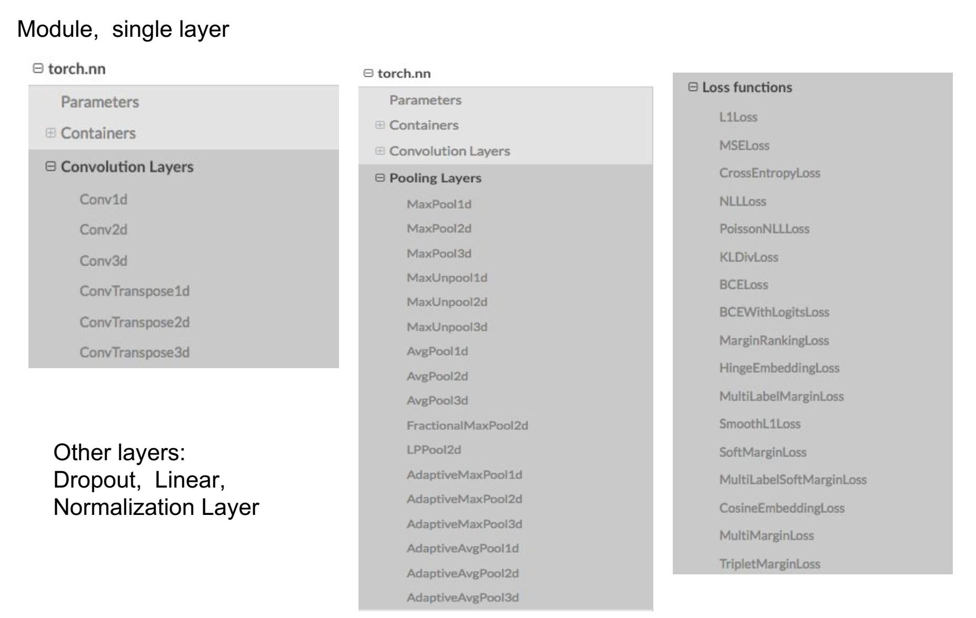
torch.nn扩展阅读
Tensors
Autograd
Examples
Extension
Experiment

Slide 56
torch.nn扩展阅读
Tensors
Autograd
Examples
Extension
Experiment
Module: creates a callable which behaves like a function, but can also contain state(such as neural net layer weights). It knows what Parameter (s) it contains and can zero all their gradients, loop through them for weight updates, etc.
Parameter: a wrapper for a tensor that tells a Module that it has weights that need updating during backprop. Only tensors with the requires_grad attribute set are updated
functional: a module(usually imported into the F namespace by convention) which contains activation functions, loss functions, etc, as well as non-stateful versions of layers such as convolutional and linear layers.

Slide 57
一些常用工具
Tensors
Autograd
Examples
Extension
Experiment
模型导入导出
可视化

Slide 58
模型导入导出
Tensors
Autograd
Examples
Extension
Experiment
三个主要函数：
torch.save: Saves a serialized object to disk. This function uses Python’s pickle utility for serialization. Models, tensors, and dictionaries of all kinds of objects can be saved using this function.
torch.load: Uses pickle’s unpickling facilities to deserialize pickled object files to memory. This function also facilitates the device to load the data into.
torch.nn.Module.load_state_dict: Loads a model’s parameter dictionary using a deserialized state_dict.
Notes:
In PyTorch, the learnable parameters (i.e. weights and biases) of an torch.nn.Module model are contained in the model’s parameters (accessed with model.parameters()). A state_dict is simply a Python dictionary object that maps each layer to its parameter tensor. Note that only layers with learnable parameters (convolutional layers, linear layers, etc.) and registered buffers (batchnorm’s running_mean) have entries in the model’s state_dict. Optimizer objects (torch.optim) also have a state_dict, which contains information about the optimizer’s state, as well as the hyperparameters used.

Slide 59
Save/Load state_dict (推荐方法)
Tensors
Autograd
Examples
Extension
Experiment
Save
torch.save(model.state_dict(), PATH)
Load
model = TheModelClass(*args, **kwargs)
model.load_state_dict(torch.load(PATH))
model.eval()
注意：Remember that you must call model.eval() to set dropout and batch normalization layers to evaluation mode before running inference. Failing to do this will yield inconsistent inference results.

Slide 60
Save/Load整个模型
Tensors
Autograd
Examples
Extension
Experiment
Save
torch.save(model, PATH)
Load
# Model class must be defined somewhere
model = torch.load(PATH)
model.eval()
Saving a model in this way will save the entire module using Python’s pickle module. The disadvantage of this approach is that the serialized data is bound to the specific classes and the exact directory structure used when the model is saved.
Notes:
The reason for this is because pickle does not save the model class itself. Rather, it saves a path to the file containing the class, which is used during load time. Because of this, your code can break in various ways when used in other projects or after refactors.

Slide 61
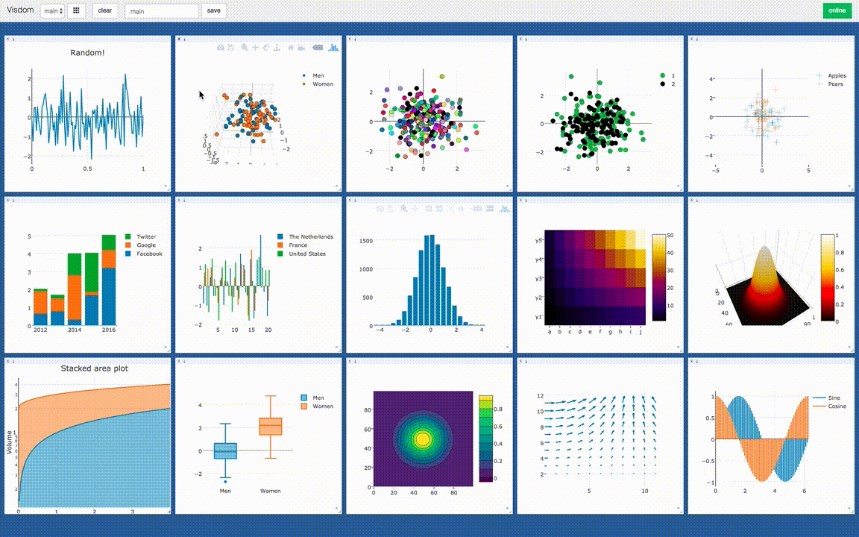
可视化——visdom
Tensors
Autograd
Examples
Extension
Experiment
pip install visdom
https://github.com/facebookresearch/visdom

Slide 62

可视化——TensorBoard
Tensors
Autograd
Examples
Extension
Experiment

Slide 63

上机实验——AI云平台
Tensors
Autograd
Examples
Extension
Experiment

Slide 64

上机实验——内部架构
Tensors
Autograd
Examples
Extension
Experiment
计算：运行于Docker容器内部
资源管理和调度：Yarn
Kubernetes负责平台各组件的部署
https://github.com/microsoft/pai

Slide 65
上机实验
Tensors
Autograd
Examples
Extension
Experiment
CPU可以在本地环境运行，GPU则在云环境中运行
https://www.bitahub.com/beta
分组后由助教统一开账号

Slide 66
扩展阅读
Tensors
Autograd
Examples
Extension
Experiment
并行处理： https://pytorch.org/tutorials/beginner/blitz/data_parallel_tutorial.html#sphx-glr-beginner-blitz-data-parallel-tutorial-py
云平台上多机并行： https://www.bitahub.com/views/article-detail.html?articleId=_1b37e7a9def34b51afd5f91d3989027f

Slide 67
谢谢！
Tensors
Autograd
Examples
Extension
Experiment
郑歆慰
xwzheng@ustc.edu.cn
2019年4月15日

Slide 68

torch.optim
一些优化算法例如Conjugate Gradient和LBFGS需要重复多次计算函数，因此你需要传入一个闭包去允许它们重新计算你的模型。这个闭包应当清空梯度， 计算损失，然后返回。

Slide 69


自定义网络层

